Slide 1
HR Data Analytics
Nazma Khatoon

Slide 2
Index No. | Title | Page No
1 | Introduction | 3
2 | Objective | 4
3 | Data Sharing Agreement | 5
4 | Data Description | 6
5 | Insights | 7
6 | My Design | 8,9

Slide 3
INTRODUCTION
Create a Power BI report for HR attrition analysis, emphasizing key metrics and trends. Explore factors driving attrition, such as job satisfaction and career growth opportunities. Segment employees based on demographics and job attributes to identify high-risk groups. Utilize predictive modeling to forecast attrition rates and suggest proactive measures for retention. Continuously monitor and update the report to track progress and improve organizational strategies.

Slide 4
OBJECTIVE
Objective: To develop a comprehensive Power BI report for HR attrition analysis, aiming to identify trends, drivers, and high-risk employee segments, thereby enabling proactive measures for retention and strategic workforce planning.

Slide 5
DATA SHARING AGGREMENT
File Name : Attrition Data.CSV
Dataset Size : 580KB
Number of Rows: 4411
Number of columns: 29

Slide 6
INSIGHTS
KPIS
Attrition by Gender
Attrition by Education
Attrition by Job Role
Attrition by Years at Company

Slide 7
KPIS

Slide 8
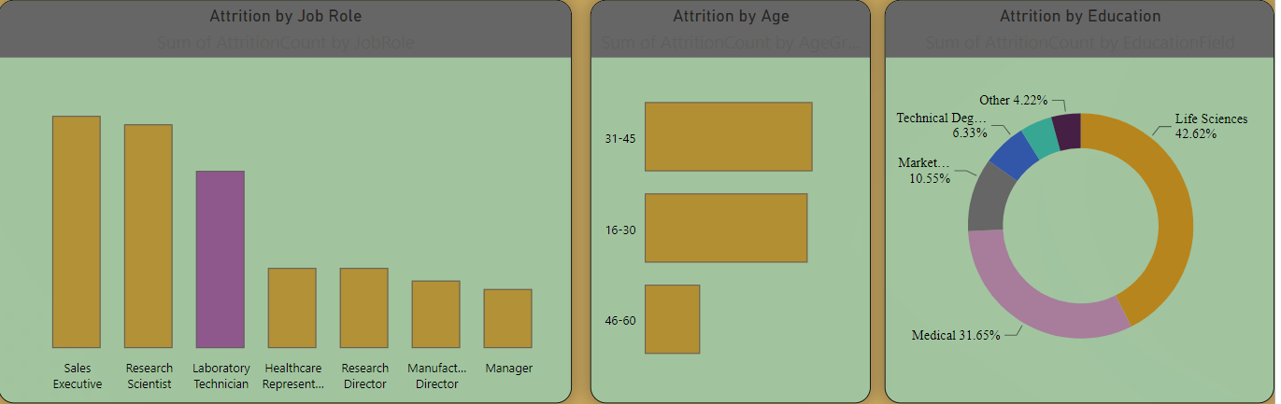
MY DESIGN

Slide 9
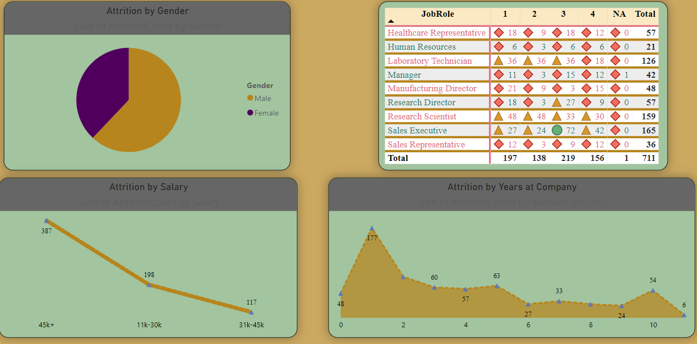

Slide 10
THANK YOU

